Slide 1

KURIKULUM ABAD 21
BAHAGIAN PEMBANGUNAN KURIKULUM
KEMENTERIAN PELAJARAN MALAYSIA

Slide 2

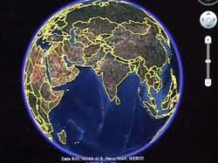
The World Has Changed
We have moved into a more demanding cognitive age, compelling people to become better at absorbing, processing and combining information.
Can we learn to change with it?
Who might our kindergarten children be working with on an on-the-job project in 2025?

Slide 3
Three Question Exercise
What will the world be like 20 years from now?
What skills will your child need to be successful in that world?
What would learning look like if it was designed around your answers?

Slide 4
Globalization Is an Integral Part of This Generation
Because of globalization—the ongoing process of intensifying economic, social, and cultural exchanges across the planet—young people the world over need more innovative thinking skills, cultural awareness, higher-order cognitive skills, and sophisticated communication and collaboration skills than ever before.
Notes:
This is the first generation in human history in which the fortunes of youth growing up far apart will be demonstrably linked by increasingly powerful global socioeconomic, political, and demographic realities.
The immediate effects of global economy when the US stock market fell
This morning in New York City, for example, youth from more than 190 countries got up to go to school, marking the first time in human history that one city represents practically every country on the planet (Linares, 2006).

Slide 5
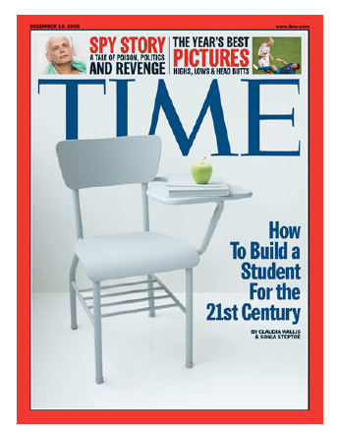
“This is the story about the big public conversation the nation is not having about public education… whether an entire generation of kids will fail to make the grade in the Global Economy because they can’t think their way through abstract problems, work in teams, distinguish good information from bad, or speak a language other than English.”
Time Magazine Dec. 18, 2006

Slide 6

Tony Wagner, co-director of the Change Leadership Group, examines the U.S. education system in the 21st century, considers why American students are falling behind their international peers, and proposes methods to begin to correct the downward slide.
The global achievement gap is the gap between what we are teaching and testing in our schools, even in the ones that are most highly-regarded, versus the skills all students will need for careers, college, and citizenship in the 21st century.
He asks them the same question, “What qualities do you most want in a potential new employee?”
Wagner hears that the single most important skill is the ability to ask the right questions
seven survival skills
critical thinking and problem solving;
collaboration across networks and leading by influence;
agility and adaptability;
initiative and entrepreneurship;
effective oral and written communication;
accessing and analyzing information; and
curiosity and imagination.

Slide 7
Challenges of 21st Century Teaching
    Greater Need for Education in Society and Economy
    Higher Standards for Learning
    More Diverse Students with Greater Educational Needs
    Greater Expectations of Schools for Ensuring Success
Notes:
Standards movement is holding kids to higher standards
Yet in many places the system has not mobilized to equalize educational opportunity or to offer kids an education that would let them meet the standards
(Funding differentials: access to qualified teachers and quality curriculum)
Teaching is more difficult and challening

Slide 8
A Changing Economy Makes “Thinking Skills” more Important
Source: Partnership for 21st Century Skills
http://www.21stcenturyskills.org/index.php?option=com_content&task=view&id=254&Itemid=120

Slide 9
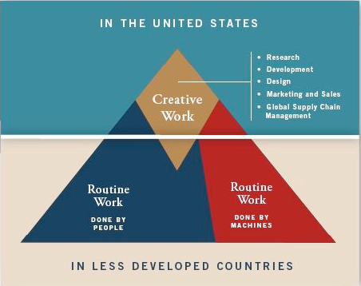
21 st Century World
The Future World of Work
Creative Work —
Research
Development
Design
Marketing/Sales
Global Supply Chain Management
Routine Work
done by people
Routine Work
done by machines
Source: Partnership for 21st Century Skills
http://www.21stcenturyskills.org/index.php?option=com_content&task=view&id=254&Itemid=120

Slide 10
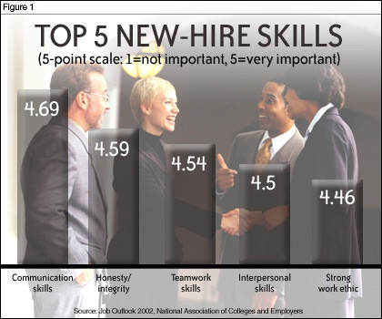
Job Outlook 2002, National Association of Colleges and Employers (NACE)

Slide 11
Pembelajaran abad ke-20
Dipimpin guru
Arahan langsung
Pengetahuan
Kandungan
Kemahiran asas
Teori
Kurikulum
Individu
Bilik darjah
Pentaksiran sumatif
Belajar untuk sekolah

Slide 12
Pembelajaran abad ke-21
Dipimpin guru
Arahan langsung
Pengetahuan
Kandungan
Kemahiran asas
Teori
Kurikulum
Individu
Bilik darjah
Pentaksiran sumatif
Belajar untuk sekolah
Berasaskan murid
Pembelajaran kolaboratif
Kemahiran
Proses
Pemikiran Aras Tinggi
Praktikal
Kemahiran hidup
Berkumpulan
Komuniti
Pentaksiran formatif
Belajar untuk kehidupan
Keseimbangan

Slide 13
"schools will be laced with a "project-based curriculum for life, aimed at engaging students in addressing real-world problems, issues important to humanity, and questions that matter. The education they receive must enhance both their knowledge and creativity. At the same time, it should enable students to think, reason, make sound decisions, work as members of a team, and see the relationships among things they're learning in various subjects--across disciplines.

Slide 14
“sekolah harus menyediakan peluang pendidikan dengan kurikulum berasaskan projek yang autentik dengan keadaan kehidupan sebenar, melibatkan murid menangani dan menyelesaikan masalah kehidupan sebenar serta isu yang penting dalam kehidupan sejagat. Pendidikan yang diberikan harus meningkatkan pengetahuan dan kreativiti murid dan pada masa yang sama membolehkan murid berfikir, menaakul, membuat keputusan yang bijak, bekerja sebagai ahli pasukan dan melihat perhubungan dan perkaitan antara ilmu yang dipelajari merentas kurikulum.”

Slide 15
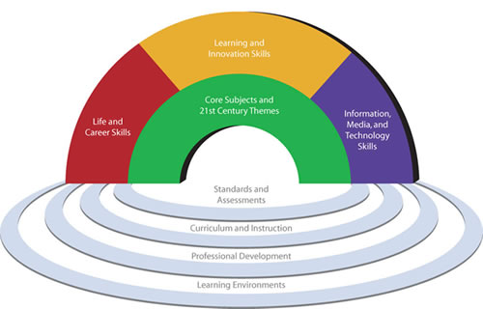
Standard kemahiran
Kreativiti & Inovasi
Pemikiran Kritis dan Penyelesaian Masalah
Komunikasi & Kolaborasi
Literasi Maklumat
Literasi Media
Literasi Teknologi Maklumat & Komunikasi)
Kemahiran belajar & Inovasi
Kemahiran hidup & kerjaya
Mata pelajaran teras dan tema Abad ke-21
Kemahiran Teknologi Maklumat, Komunikasi & Media
Kebolehsuaian & fleksibel
Mempunyai inisiatif dan terarah kendiri
Kemahiran sosial dan antara budaya
Produktiviti & akauntabiliti
Tanggungjawab dan kepimpinan
Menggunakan teknologi untuk mengakses, mengurus, mengintegrasi dan menilai maklumat, menjana maklumat baru dan berkomunikasi dengan orang lain
Kurikulum
Standard &
Pentaksiran
Pembangunan Profesional
Persekitaran Pembelajaran

Slide 16




“Kandungan” bagi Abad ke-21
Kurikulum Teras + Tema
Kesedaran global
Literasi kewangan, ekonomi, perdagangan dan
keusahawanan
Literasi sivik
Kesedaran Alam Sekitar
Kesedaran tentang
aspek kesihatan & kesejahteraan

Slide 17
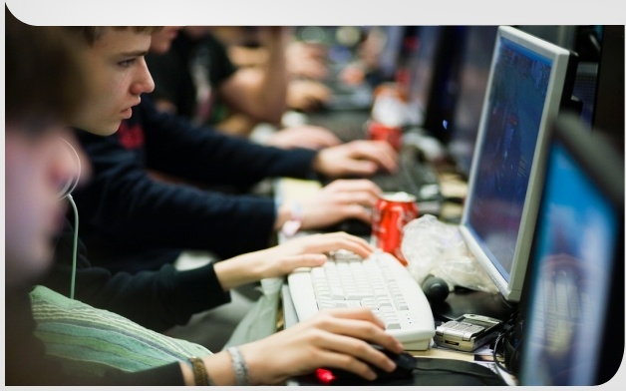
Kemahiran belajar abad ke-21
Kemahiran Maklumat & Komunikasi
  Literasi maklumat & media
  Kemahiran berkomunikasi
Kemahiran Berfikir Dan Menyelesaikan Masalah
  Pemikiran kritikal dan Bersistem
  Penyelesaian Masalah
  Kreativiti & Semangat Meneroka
Kemahiran Interpersonal & Arah Kendiri
  Kemahiran Interpersonal dan Kolaborasi
  Arah Kendiri
  Akauntabiliti & adaptasi
  Tanggungjawab Sosial

Slide 18
Perubahan kepada hasrat pendidikan
Konteks pembelajaran baru membawa perubahan kepada apa yang dijangkakan melalui pendidikan dan ini melibatkan:
  Kebolehan berkomunikasi
  Kebolehsesuaian untuk berubah
  Kebolehan bekerja dalam pasukan
  Kesediaan menyelesaikan masalah
  Kebolehan menganalisis dan mengkonsepsikan
  Kebolehan membuat refleksi dan menambah baik
  Kebolehan mengurus kendiri
  Kebolehan mencipta, membuat inovasi dan mengkritik
  Kebolehan untuk belajar sepanjang hayat
  Kebolehan untuk mahir dalam pelbagai bidang (cross specialist )

Slide 19
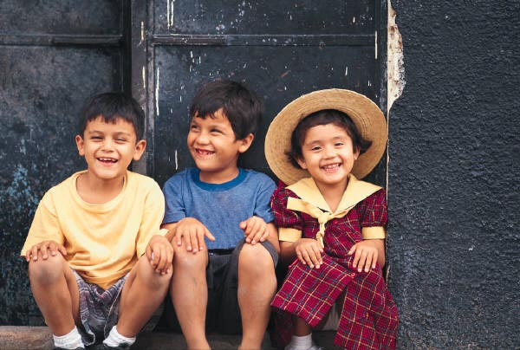
Kurikulum yang direkabentuk menuntut kita untuk membuat pilihan tentang apakah yang penting pada masa kini bagi membantu pelajar untuk masa depan mereka.

Slide 20
Why are 21st century skills so important?
There are new 21st Century Contexts
Global Competition
Global Cooperation
Information Growth
More Jobs & Careers
Service Economy

Slide 21








Are our students ready?
Are our students critical thinkers and problem solvers?
Are our students globally aware?
Are our students self-directed?
Are our students good collaborators?

Slide 22
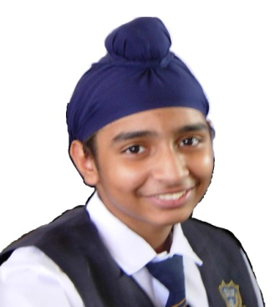
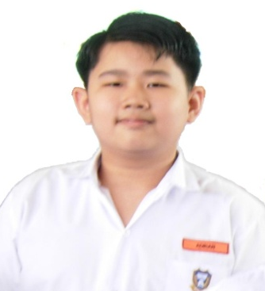

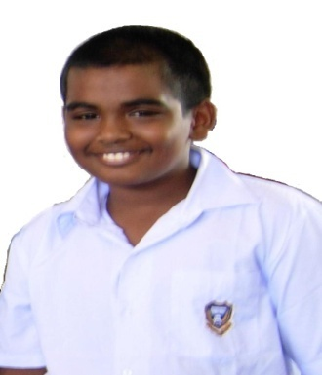
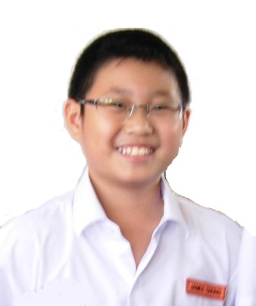
CIRI-CIRI INSAN MURID YANG DIHASRATKAN
Berupaya Membuat Hubung-kait
Menyoal
Yakin – mengambil risiko
Berkemahiran
Tidak berputus asa
Berdikari
Dahagakan ilmu
Kritikal
Kreatif
Berani Mencuba
Ingin tahu
Menguasai kemahiran literasi
Bijak berkomunikasi
Menjana idea
mampu mencorak
Fleksibel
Mendengar dan membuat refleksi
Membuat inisiatif
Mampu bekerja dengan orang lain
berintegriti
Berkeperibadian tinggi
Mampu berfikir sendiri
Belajar dari kesilapan
Semangat ‘ sentiasa boleh’
Membuat perubahan

